Slide 1

CONTROL AND DIAGNOSTICS INSTRUMENTS FOR
HIGH-VOLTAGE
CIRCUIT BREAKERS AND TRANSFORMERS

Slide 2
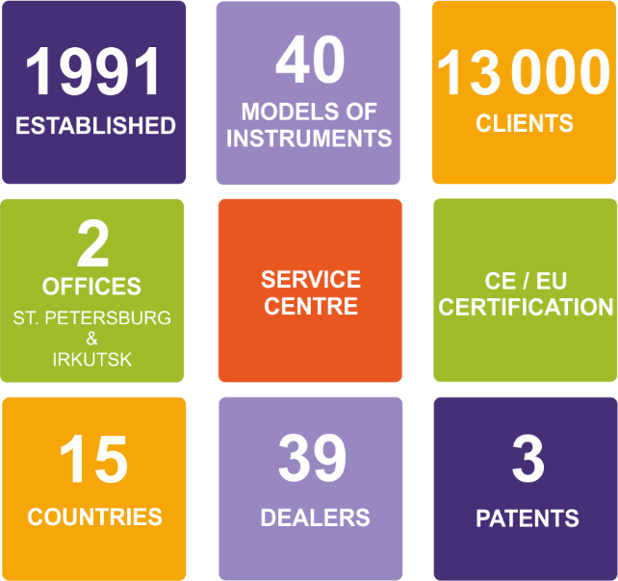
SKB EP, LLC
INNOVATIVE FULL CYCLE ENTERPRISE

Slide 3

SKB EP, LLC
INNOVATIVE FULL CYCLE ENTERPRISE

Slide 4
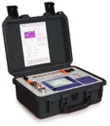



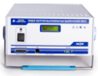






INSTRUMENTS FOR HIGH-VOLTAGE ELECTROTECHNICAL EQUIPMENT
CIRCUIT BREAKER ANALYZERS
OLTC ANALYZERS
PKV/М7
PKV/U3
PKV/М17
PKR-2
PKR-2М
CONTACT AND WINDING RESISTANCE METERS
MIKO-10
MIKO-21
MIKO-2.3
MIKO-7М(А)
MIKO-8М(А)
MIKO-9А

Slide 5












SUBSTITUTION
OF THE FOLLOWING BRANDS
Notes:
ТИПОВОЙ СЛАЙД - КЛИЕНТЫ

Slide 6









CERTIFICATION
CE Conformity
Certificate
Declaration of
Conformity of the
Customs Union
Russian Register
of Innovative
Products
Safety Test
Certificate
IEC 61010-1:2001
Russian State
Register Certificates
PJSC ROSSETI Register
of Innovative Solutions
Conformity with the safety requirements of the Russian Federation
Recommended for use
in JSC Russian Railways
electric installations
EMC Compatibility
IEC 61326-1:2005
WWW.SKBEP.COM

Slide 7
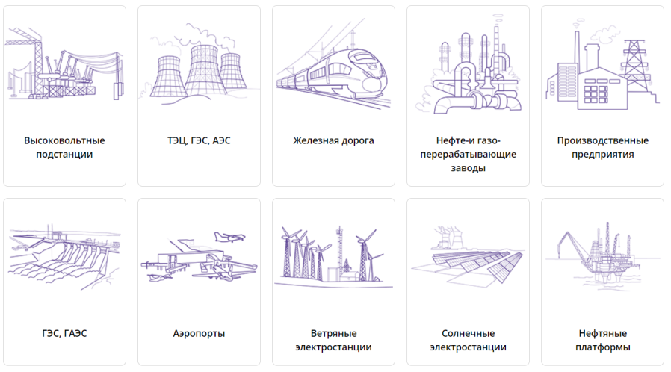
APPLICATION AREA
OF THE INSTRUMENTS
High-voltage substations
Central Heating and Power Plants, Nuclear Power Stations
Rail facilities
Oil- and gas- processing
plants
Manufacturing facilities
Hydroelectric Power Stations,
Pumped-storage Hydro Station
Airports
Wind
Power Plant
Solar
Power Station
Oil
platforms

Slide 8












CLIENTS
MORE THAN 13 000 ENTERPRISES

Slide 9
CONTROL AND DIAGNOSTICS INSTRUMENTS FOR
HIGH-VOLTAGE CIRCUIT BREAKERS
PKV-GROUP INSTRUMENTS

Slide 10
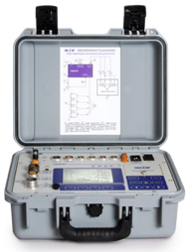
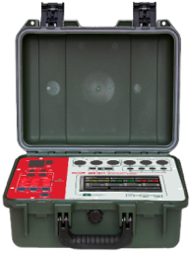
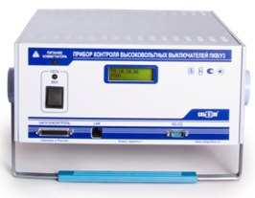
INSTRUMENTS FOR
HIGH-VOLTAGE CIRCUIT BREAKERS
INCREASE LIFETIME OF THE CIRCUIT BREAKER BY 1.5 TIMES
REDUCE REPAIR COSTS BY 30%
THE LARGEST BUILT-IN «KNOWLEDGE» BASE
PKV/М7
PKV/U3
PKV/М17

Slide 11
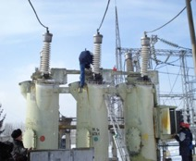
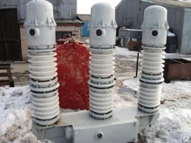
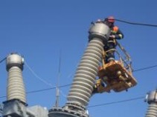
PKV-GROUP INSTRUMENTS
MAIN FAULTS THAT CAN BE IDENTIFIED
  Time delay during circuit breaker closing or opening;
  Circuit breaker poles time difference;
  Strong contact bounce;
  Insufficient contact pressure;
  Contact reclosure during circuit breaker opening;
  Mismatch between main and accompanying contacts;
  Mashing in the driving gear;
  Malfunction of the trip dashpot (damper device);
  The wear and tear of the springs inside the arc extinguish chambers, etc.

Slide 12
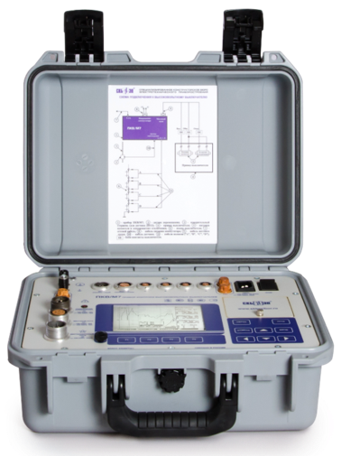


PKV/M7
HV CIRCUIT BREAKER ANALYZER
4-digit channel for connecting regular travel transducers or for circuit breaker control with 4 breaks per pole (including air circuit breakers);
Additional channel for synchronizing and measuring of currents and voltages of coils of closing and opening electromagnets;
Universal analog channel for measuring volt-ampere characteristics of resistive sensors, electronic control circuits and connection of current pliers for monitoring high solenoid currents;
An ability to configure measurement process to the circuit breaker of any type (manufactured both in Russia or in foreign countries);
Multifunctional interface that allows you to work from a PC as well.

Slide 13
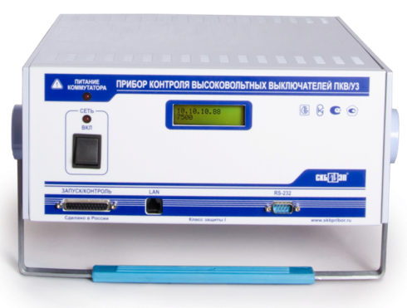
PKV/U3
HV CIRCUIT BREAKER ANALYZER
Powerful commutator up to 35A;
20 discrete channels make it possible to control up to five breaks per pole of air, vacuum, oil, and SF6 circuit breakers;
3 transducer channels enable simultaneous control of three poles in one operation;
2 analog channels help to connect current clamps or dividers to both control circuits of a circuit breaker at the same time ;
Wide possibilities of computer control system.

Slide 14

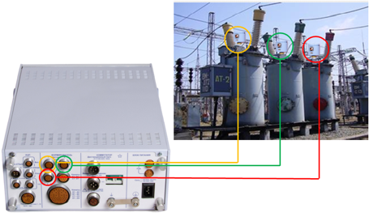

PKV/U3
HOW TO CONNECT TO THE CIRCUIT BREAKER
+220
YA1
-220
YA2
K
GEN
SOL.OPEN
SOL.CLOSE
=220
Power cable adapter
~220

Slide 15
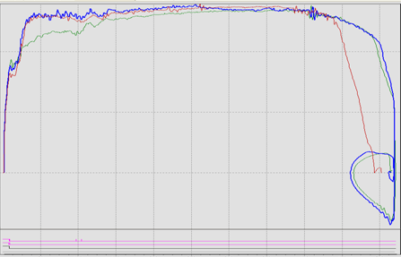
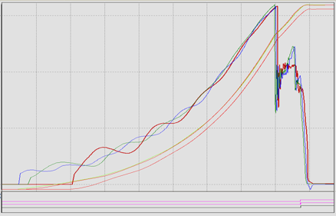
PKV/U3
OPENING/CLOSING GRAPHS WITH FAULTS
Opening of a circuit breaker with a poorly functioning oil buffer.
Closing of the circuit breaker with tightly clamped bridles of the guide system.

Slide 16
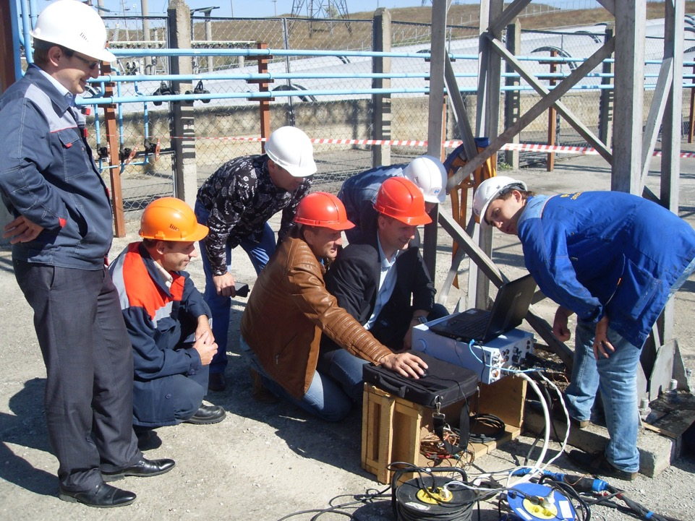
SKB EP INSTRUMENTS
EXAMPLE OF USE

Slide 17

SKB EP HV CIRCUIT BREAKER ANALYZERS
ADVANTAGES OF USE
Disassembly of larger part of the circuit breaker isn’t required;
Different circuit breaker parts are controlled at the same time;
Even small troubles in the mechanism of the circuit breaker are recognized;
All the results are automatically controlled.

Slide 18
RESISTANCE MEASUREMENT
MICROOHMMETERS

Slide 19
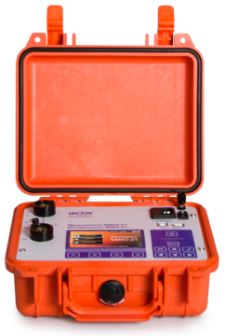
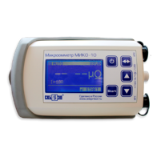
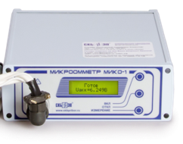
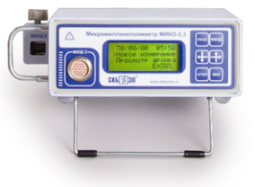
MICROMILLIKILOOHMMETER
AND MICROOHMMETERS
MEET RUSSIAN AND INTERNATIONAL STANDARDS
WIDE CHOICE OF TEST CABLES
MIKO-10
test current 10 А
MIKO-1
test current up to 50 А
MIKO-21
test current up to 200 А
MIKO-2.3
test current up to 1000 А

Slide 20

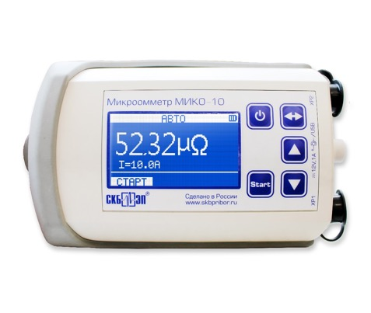
MIKO-10
SMALL-SIZE MICROOHMMETER
Test current up to 10 А;
Resistance range 1 µΩ ÷ 0.1 Ω;
Accuracy ±0.2%;
Three special modes to start the measurement process;
In-built battery with power of up to 6 hours of operation.
NO ANALOGUE

Slide 21
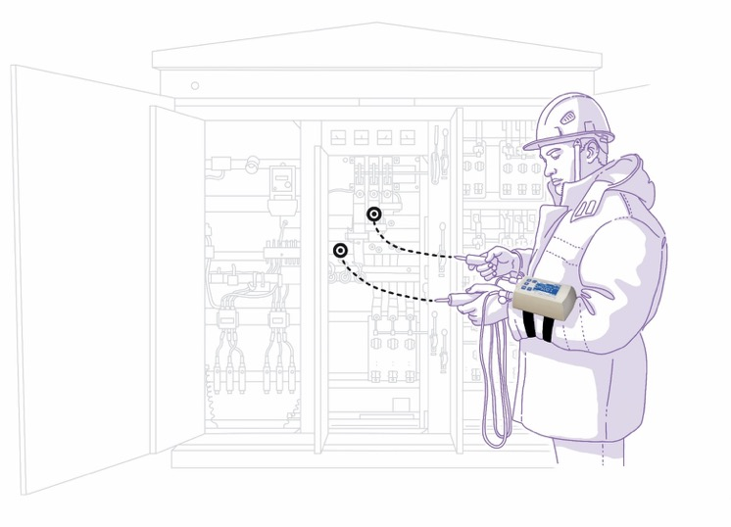
MIKO-10
SMALL-SIZE MICROOHMMETER
THREE WAYS TO FIX THE INSTRUMENT
HANDS ARE FREE
DURING THE OPERATION
ON THE HAND;
ON THE WAIST;
ON THE NECK.

Slide 22
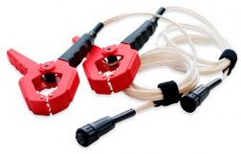
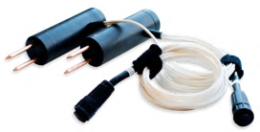
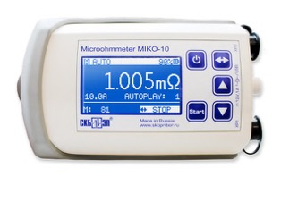

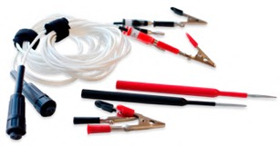
MIKO-10
SMALL-SIZE MICROOHMMETER
NO ANALOGUE

Slide 23
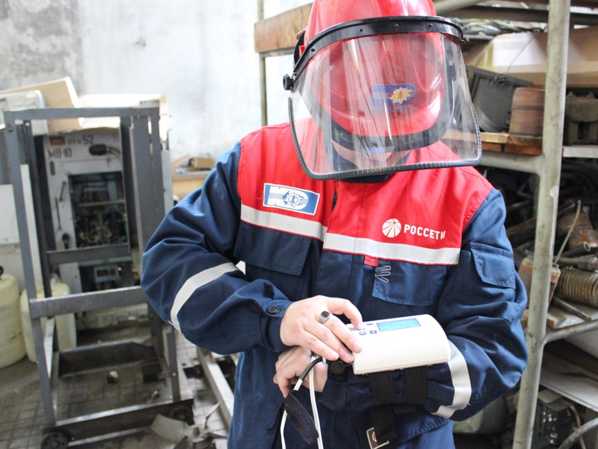
SKB EP INSTRUMENTS
EXAMPLE OF USE

Slide 24
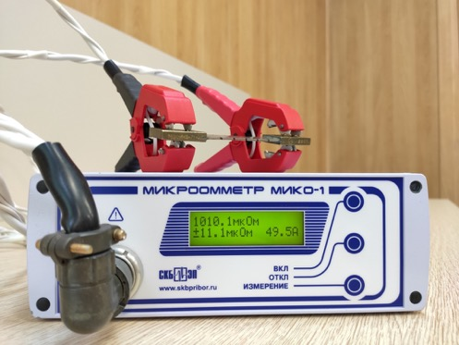
MIKO-1
INDUSTRIAL MICROOHMMETER
Test current up to 50 А;
Resistance range 1 µΩ ÷ 20 mΩ;
MIKO-1 stabilizes test current during the measurement
Accuracy < 1%;
Battery power
(more than 100 measurements).

Slide 25

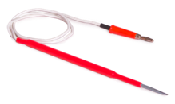
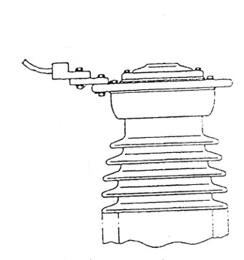
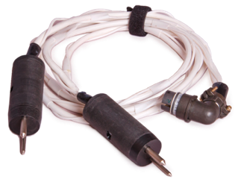
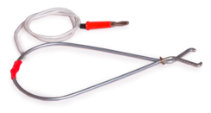
MIKO-1
HOW TO CONNECT TO THE OBJECT
Resistance measurement points
4
3
2
1

Slide 26
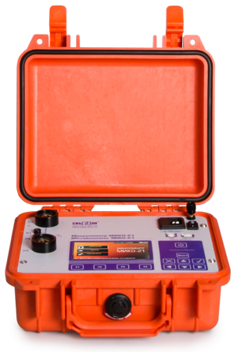
MIKO-21
HIGH-PRECISION MICROOHMMETER
Test current up to 200 А;
Resistance range 0.1 µΩ ÷ 2 Ω;
Accuracy ±0.05%;
Specialized measurement algorithms;
In-built memory 2000 measurements;
Battery power;
Operating t˚ range: -20ºС ÷ +50ºС.

Slide 27


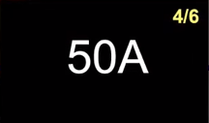



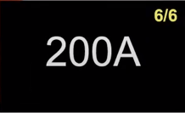
MIKO-21
TEST CURRENT
9nze39

Slide 28

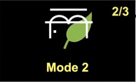

MIKO-21
MEASUREMENT MODES
without current transformers,
and of any demountable or
non-demountable connections
with current transformers,
and with energy-saving algorithms
with current transformers,
with max duration of the test current, and without energy-saving algorithms

Slide 29
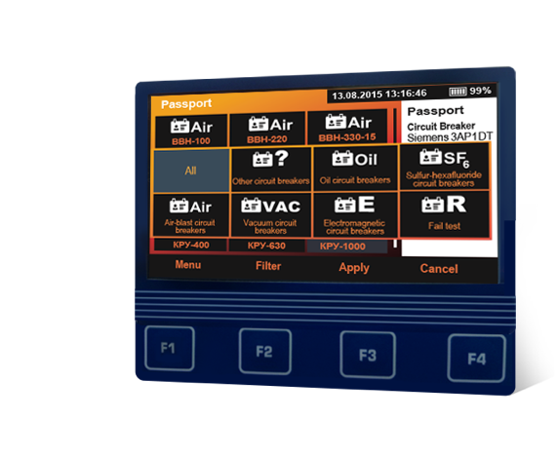
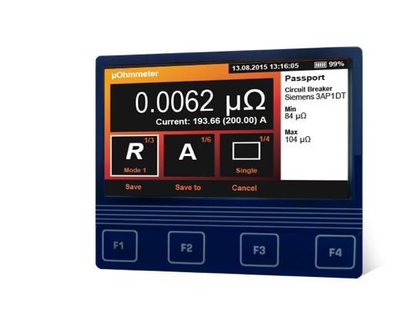
MIKO-21
HIGH-PRECISION MICROOHMMETER
AUTOMATICALLY DETECTS
THE OUTPUT OF THE MEASUREMENT RESULTS
BEYOND THE ALLOWED LIMITS

Slide 30
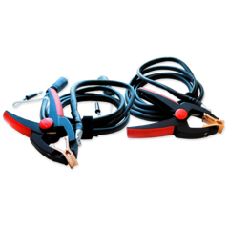
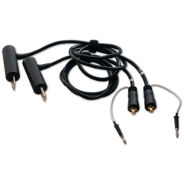
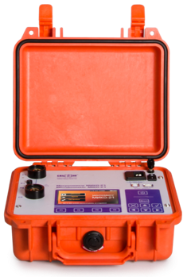
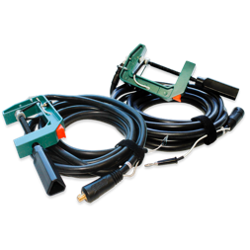
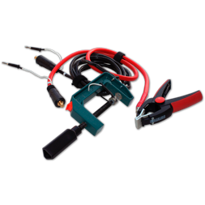
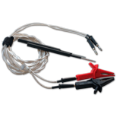

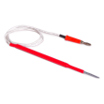
MIKO-21
HIGH-PRECISION MICROOHMMETER

Slide 31



SKB EP MICROOHMMETERS
ADVANTAGES OF USE
SMALL-SIZE MIKO-10 with fully automated measurement mode.
SIMPLE-TO-USE MIKO-1 with test current of 50 А.
HIGH-PRECISION MIKO-21 with an archive of nominal values of high-voltage circuit breakers resistances and special modes to measure resistances in circuits with in-built current transformers.

Slide 32
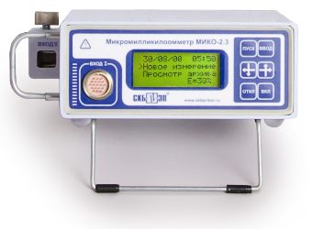
MIKO-2.3
MICROMILLIKILOOHMMETER
Self-tuning to the measurement object;
Self-contained power supply due to the in-built battery: charging time 3-4 min;
In-built memory and data transfer to a PC via RS-232- USB cable;
Small weight of only 2.7 kg and test current up to 1 000 А.

Slide 33
MIKO-2.3
MICROMILLIKILOOHMMETER
MICROOHMMETER
Resistance range | 1 µΩ ÷ 10⁵ µΩ
Test current range | 10 A ÷ 1 000 А
MILLIOHMMETER
Resistance range | 0.1 mΩ ÷ 10⁶ mΩ
Test current range | до 5 А
KILOOHMMETER
Resistance range | 0.1 kΩ ÷ 300 kΩ
Accuracy | ± 0.5%
THERMOMETER
Thermometer range | - 20˚С ÷ +120˚С

Slide 34
WINDING RESISTANCE METERS
MILLIOHMMETERS

Slide 35
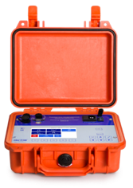
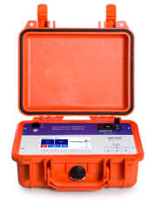
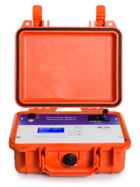




MILLIOHMMETERS
NEW DEVELOPMENT
FULL AUTOMATIZATION
OF MEASUREMENT RESULTS PROCESSING
OUTPUT CAPACITY 60 W
MIKO-9А
MIKO-8М(А)
MIKO-7М(А)
SUBSTITUION OF THE FOLLOWING BRANDS:

Slide 36
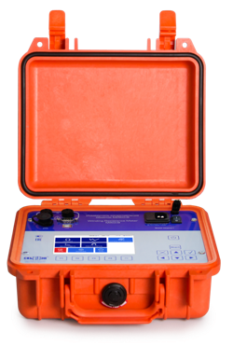
MILLIOHMMETERS
MAIN FAULTS THAT CAN BE IDENTIFIED
  Circuit opening or interturn short circuit;
  Solder violation;
  Poor-quality contact connections;
  Incorrect installation of the OLTC drive;
  OLTC device malfunctions.

Slide 37

MILLIOHMMETERS
 | MIKO-9А | MIKO-8М(А) | MIKO-7М(А)
Resistance range | 1 µΩ ÷ 30 kΩ | 1 µΩ ÷ 10 kΩ | 1 µΩ ÷ 2 kΩ
Max test current | 10 А | 10 А | 10 А
Milliohmmeter mode
Microohmmeter mode
Display | Color graphic TFT touch-screen 800 x 480 pix | Color graphic TFT touch-screen 800 x 480 pix | Monochrome graphic 128 x 64 pix
Power supply | mains and battery power | mains and/or battery power | mains and/or battery power

Slide 38










MILLIOHMMETERS
 | MIKO-9А | MIKO-8М(А) | MIKO-7М(А)
Choice of the diagnostics object
Number of in-built diagnostics objects | 10 | 10 | 5
Voltage transformer
Current transformer
Resistive object
Inductive object
Power transformer
Generator
Compensator
Filter
Motor
Electromagnet

Slide 39


MILLIOHMMETERS
 | MIKO-9А | MIKO-8М(А) | MIKO-7М(А)
Auto measurement results processing
Calculation of relative deviations of three phase windings resistance between each other;
Conversation of linear resistance into phase resistance;
etc.

Slide 40
MILLIOHMMETERS
 | MIKO-9А | MIKO-8М(А) | MIKO-7М(А)
Non-demountable estimation of OLTC devices
Express diagnostics of the state of the transformer OLTC at all weather conditions;
Construction of the oscillogram of contactor operation without opening the OLTC tank;
Analysis of the graphics of the measurement object directly on the device;
Localization of the OLTC’s problem: for instance, detection of a break in current-limiting resistors, poor selector contact, etc.

Slide 41

MILLIOHMMETERS
 | MIKO-9А | MIKO-8М(А) | MIKO-7М(А)
Auto 3-phase mode
Simultaneous connection
to 3 phases of the transformer
and resistance measurement
with auto switch between phases

Slide 42

MILLIOHMMETERS
 | MIKO-9А | MIKO-8М(А) | MIKO-7М(А)
2 windings mode
2 windings mode is designed to reduce the stabilization time on low-resistance windings.
The goal is to reduce the inductance of the magnetization by saturating the magnetic circuit with a high-voltage winding, as the saturation current is much lower on the high-voltage side than on the low-voltage side.

Slide 43

MILLIOHMMETERS
DEMAGNETIZATION MODE
 | MIKO-9А | MIKO-8М(А) | MIKO-7М(А)
Demagnetization mode
Before carrying out the open circuit test
of the transformer it is necessary to demagnetize
its magnetic core from the remanent magnetization.
Remanent magnetization relieving is performed
by passing a direct current of opposite polarities along one of the windings of each rod of the transformer's magnetic core.

Slide 44

MILLIOHMMETERS
HEAT RUN TEST
 | MIKO-9А | MIKO-8М(А) | MIKO-7М(А)
Heat run test
Heat run test
Winding
Waiting for the start
A periodic measurement of the transformer winding resistance is made in this mode.
A cooling curve is constructed from the data obtained.
Phase

Slide 45

SKB EP INSTRUMENTS
EXAMPLE OF USE

Slide 46
OLTC ANALYZERS
PKR-GROUP INSTRUMENTS

Slide 47

PKR-2 / PKR-2M
TRANSFORMER OLTC ANALYZER
3 channels for simultaneous control of three phases;
1 transducer channel to mark the shaft speed;
1 mode for manual control of OLTCs on the indicators;
2 auto modes to record radial diagrams for the OLTCs of resistor or reactor types;
Switchover oscillography of the resistor type OLTC contactor by demountable and/or non-demountable method (DRM test).
NO ANALOGUE

Slide 48

SKB EP INSTRUMENTS
EXAMPLE OF USE

Slide 49


PKR-2 / PKR-2M
CIRCULAR DIAGRAMS

Slide 50


DEMOUNTABLE DIAGNOSTICS
W/O DRAINING / WITH PARTIAL OIL DRAINING

Slide 51

DEMOUNTABLE DIAGNOSTICS
W/O DRAINING / WITH PARTIAL OIL DRAINING

Slide 52
DRM TEST
NON-DEMOUNTABLE CONTROL OF OLTC
DRM (Dynamic Resistance Measurement or DRM test)
is the measurement of dynamic resistances in the OLTC’s contactor.
DRM test is the only method that allows to carry out an effective estimation of the OLTC's technical state in a non-demountable way (without opening the contactor tank cover).
DRM is sequentially performed for all OLTC positions
in the forward and reverse directions of the selector operation.

Slide 53



PKR-2М
RECORDED OSCILLOGRAMS
ATDCN 250000/220 transformer
Non-demountable diagnostics of the OLTC (DRM test)
Demountable diagnostics
of the OLTC

Slide 54

DRM test made by PKR-2М analyzer
DRM test MR
VACUTAP®

Slide 55


OLTC DEVICE
SELECTOR CONTACTS BURN
Selector contacts burn

Slide 56
PKR-GROUP
MAIN FAULTS THAT CAN BE IDENTIFIED
Break of current-limiting resistors of high-speed OLTCs;
Contactor switch time delay;
OLTC drive faults;
Selector malfunctions.

Slide 57
MANIPULATING ROD
2.2 m | 3.7 m | 5.1 m

Slide 58

MANIPULATING ROD
Up to 35 kV | 2.2 m | 3.4 kg
Up to 110 kV | 3.7 m | 4 kg
Up to 220 kV | 5.1 m | 4.6 kg

Slide 59

MANIPULATING ROD

Slide 60

MANIPULATING ROD
NO ANALOGUE

Slide 61

COOPERATION WITH SKB EP
CLEAR PRICE FORMATION;
TECHNICAL AND COMMERCIAL TRAINING;
COMPREHENSIVE TECHNICAL
AND SALES SUPPORT 24/7;
WIDE RANGE OF MARKETING COLLATERAL AND SUPPORTING TECHNICAL LITERATURE,
USER MANUALS, WEB MATERIALS,
COMPETITOR ANALYSIS INFORMATION
AND DISTRIBUTOR PACKS;
ABILITY TO COMPETE WITH
DIFFERENT BRANDS;
ATTEND JOINT VISITS WITH AGREED
KEY CUSTOMERS.

Slide 62



COOPERATION WITH SKB EP
Russia
EU coutries:
Latvia, Lithuania, Republic of Bulgari
Asia:
Vietnam, Thailand, Indonesia, Singapur; the Kingdom of Cambodia
South America:
Peru, Ecuador
CIS:
Azerbaijan, Belarus, Kazakhstan, Kyrgyzstan, Moldova, Uzbekistan, Ukraine, Georgia

Slide 63

SKB EP INSTRUMENTS
ADVANTAGES OF USE
TIME AND COST SAVING;
LABOUR SAVING;
HIGH ACCURACY;
FULL AUTOMATIZATION
OF THE MEASUREMENT PROCESS.

Slide 64





SOCIAL MEDIA NAME:
SKBPRIBOR

